Slide 1
Robust Fiber Optics for Ground Combat Vehicles
Heath Kouns, Marc Simms, Evan Weiss, Joe Breedlove
Moog Inc. | GVSETS 2026
DISTRIBUTION STATEMENT A.
Approved for public release; distribution is unlimited.

Slide 2

Ground Vehicles are Data Networks
High-resolution sensors, sensor fusion, and autonomy are driving bandwidth demand
Low-latency, EMI-resilient data paths are mission critical
Network architecture is critical to future lethality
MOSA drives modular, interoperable networks

Slide 3
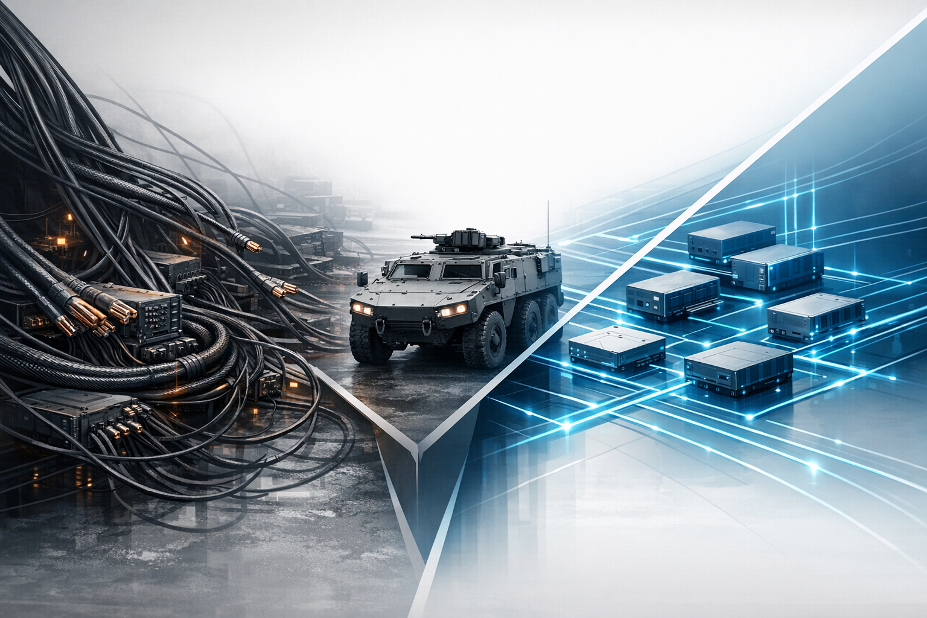
Copper Is Becoming the Bottleneck
Copper adds weight and consumes limited vehicle space
EMI control, shielding, and grounding become harder as networks scale
As bandwidth rises, copper faces signal-integrity and scaling limits
Legacy physical layers limit future network architecture

Slide 4
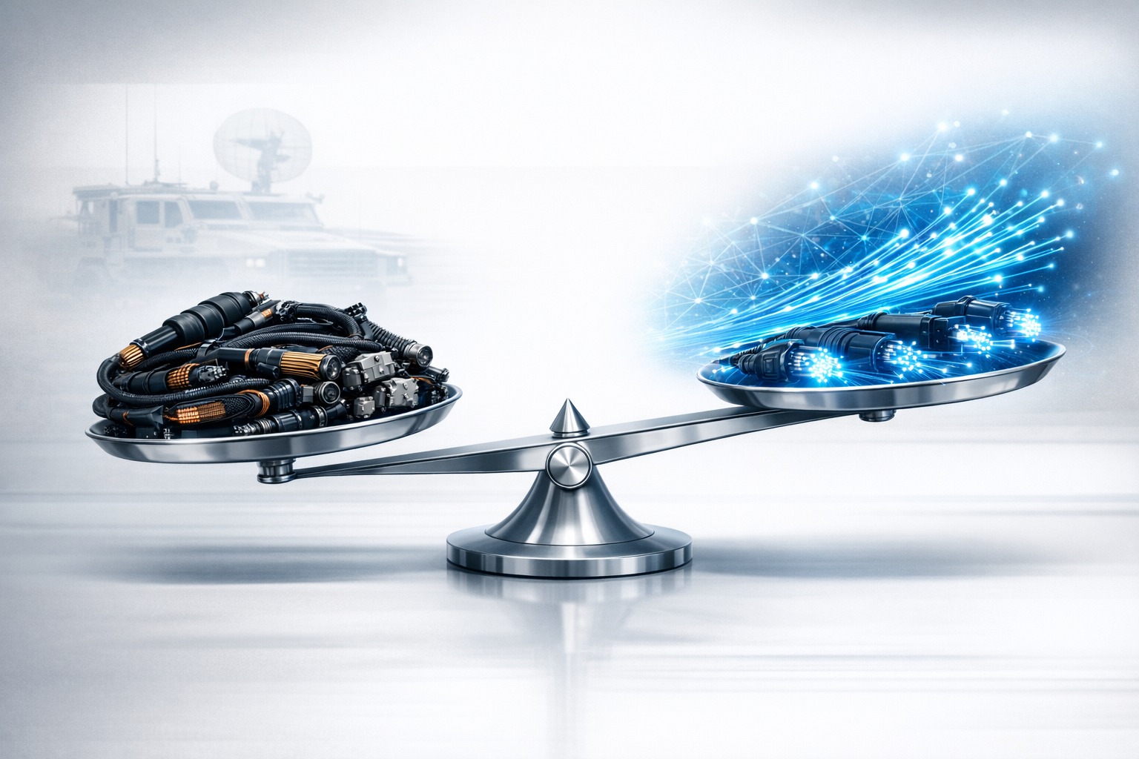
The Challenge Isn’t Performance — It’s Trust
Operators and maintainers often perceive fiber as less durable
Connector handling and contamination concerns dominate perception
Retrofit and sustainment concerns have delayed adoption
When the physical layer isn’t trusted, architecture progress stalls
Legacy
Future

Slide 5
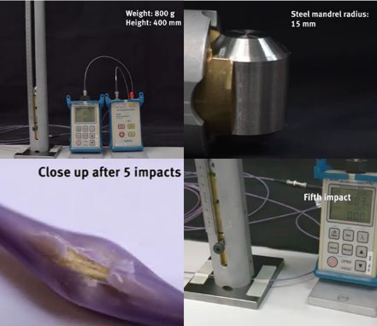
The Problem is not the Glass
Fiber in vehicle harnesses is more durable than commonly assumed
Most failures come from improper routing (micro bends), contamination, or retention and strain relief issues
Fiber failure modes differ from copper, but are not inherently worse
Radiation induced fiber darkening is not a primary concern for ground vehicles

Slide 6
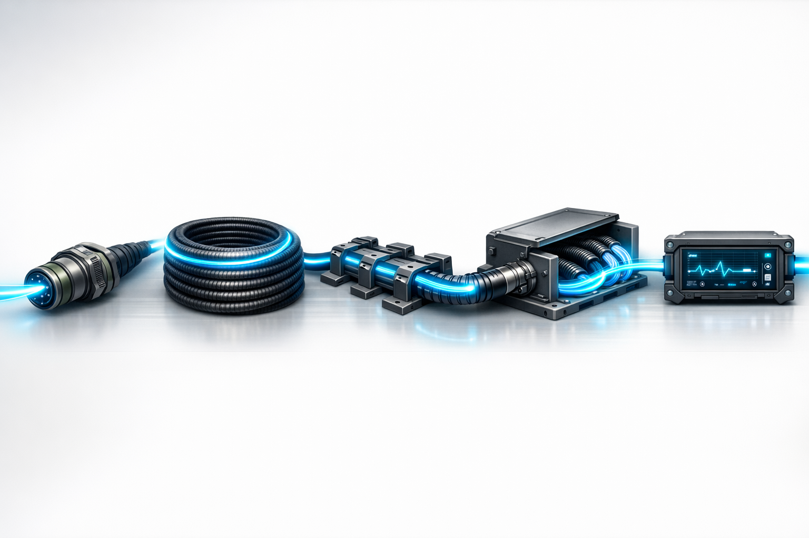
Survivability Depends on System Integration
Qualified parts alone do not create a robust optical network
Cable design, connector selection, routing, and diagnostics all matter
System integration determines survivability and maintainability
The right design practices turn optical advantages into operational value
Connector
Routing
Diagnostics
Cable
Protection

Slide 7
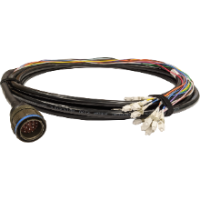
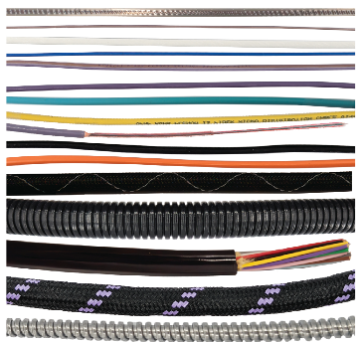
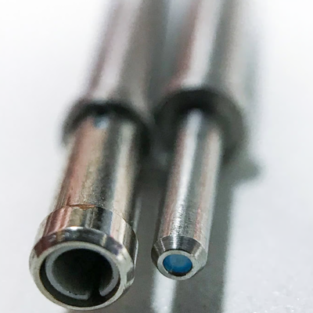
Modern Optical Hardware Solves Legacy Concerns
Bend-insensitive fibers and crush-resistant cable designs improve survivability
Reinforced cable constructions and rugged jackets protect against vehicle and operator abuse
Improved termini and interconnects reduce contamination sensitivity
Modern optical hardware is materially different from legacy telecom assumptions

Slide 8

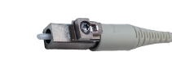
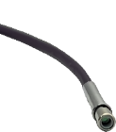
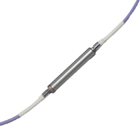

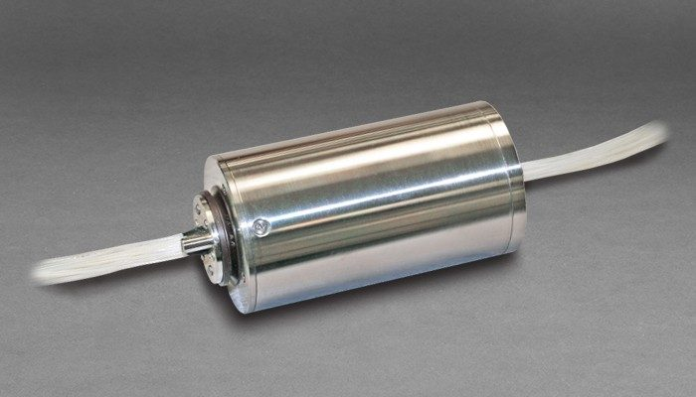
Rugged Passive Optical Building Blocks
Rugged discrete and multichannel
connectors harden the
interconnect layer
Expanded-beam termini improve
tolerance to dirt and repeated
mate/demate cycles
FORJs and High-Speed Data Links preserve bandwidth across rotating interfaces
Rugged LCs
Rugged MT
Expanded Beam
Field Installable Splices

Slide 9

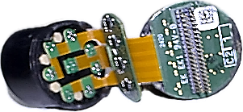
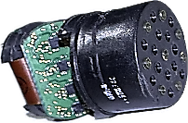
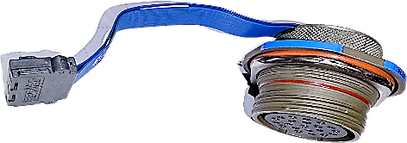
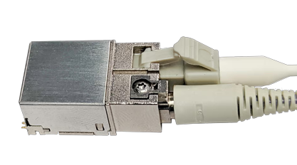
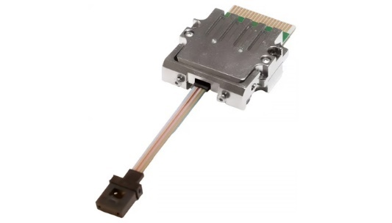
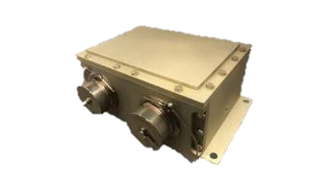
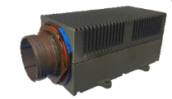
Rugged Active Optical Building Blocks
Transceivers integrated into bulkhead connectors simplify transitions for legacy copper boxes
Rugged board-level transceivers preserve standard optical interfaces while improving survivability under vehicle shock, vibration, temperature, and contamination
Ruggedized media converters and switches enable reliable Video and Ethernet links over fiber in harsh vehicle EMI environments

Slide 10
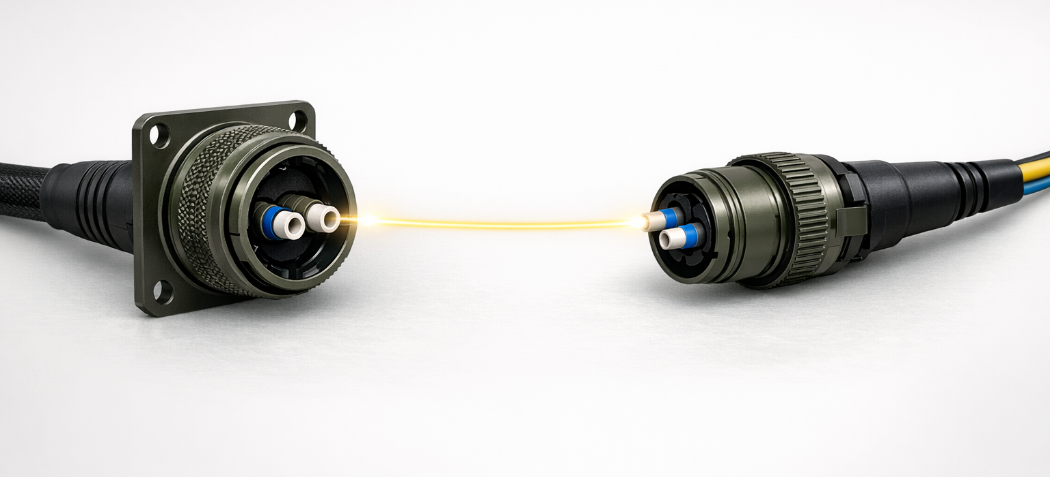
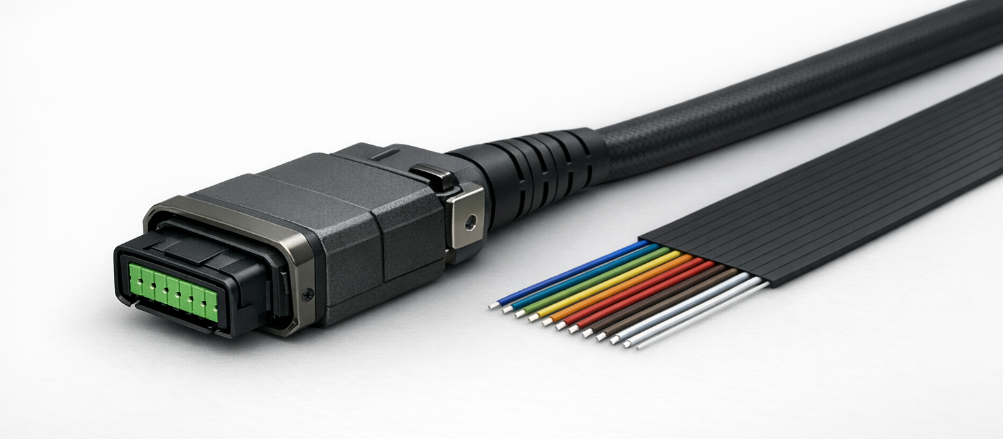
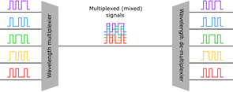
Choose the Right Optical Architecture
Point-to-point: simple, direct, proven
Parallel optics: scale bandwidth by adding lanes
WDM: expand capacity with fewer fibers
Match the optical architecture to platform
constraints and future growth

Slide 11
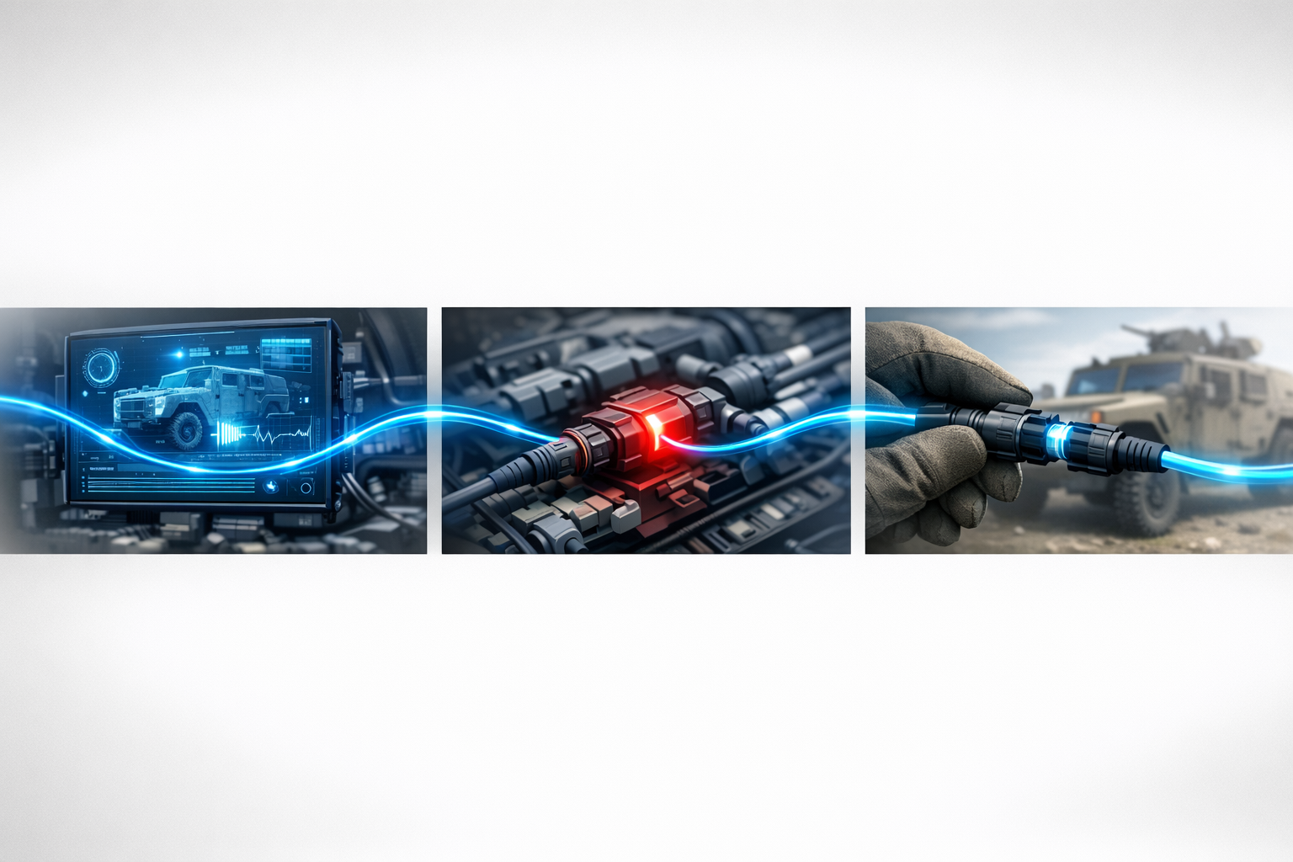
Maintainability Must Be Designed In
Use contamination tolerant interfaces where possible
Integrate Built-In Test (BIT) and link diagnostics to speed fault isolation and provide predictive maintenance alerts
Enable field repair with splice kits and modular replacement strategies
Diagnostics and repair procedures should be part of the starting architecture

Slide 12
Ground Vehicles Need an Optical Backbone
Bandwidth is now a mission driver
Ruggedization is a system engineering discipline
Fiber is ready for broader ground vehicle adoption
Treat fiber as a backbone, not a one-for-one copper replacement
The question is no longer whether fiber can survive in combat vehicles — it is where and how to deploy it for the mission.

Slide 13


Questions
Thank you for your attention.
Contact:
Heath Kouns
hkouns@moog.com

